Slide 1
GBIF and IPT2 community resources
Yu-Huang Wang
June 26, 2012

Slide 2
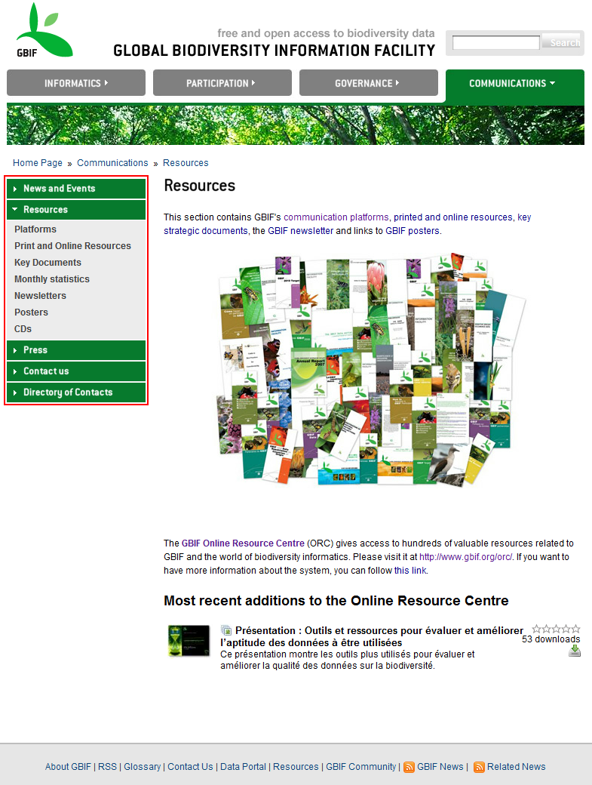
GBIF resources
http://www.gbif.org/communications/resources/

Slide 3
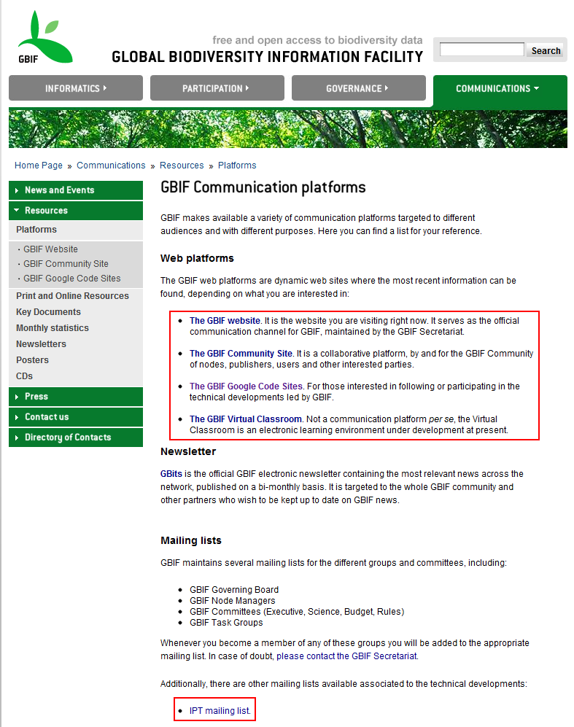
GBIF communication platform
http://www.gbif.org/communications/resources/platforms/

Slide 4
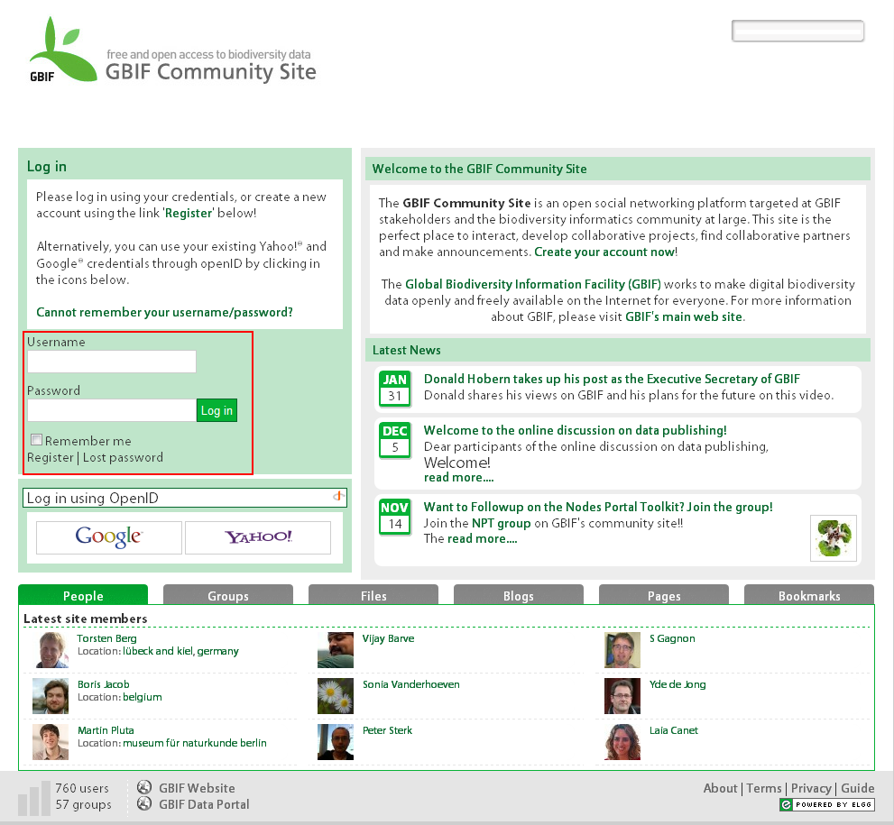
GBIF community site
http://community.gbif.org/

Slide 5
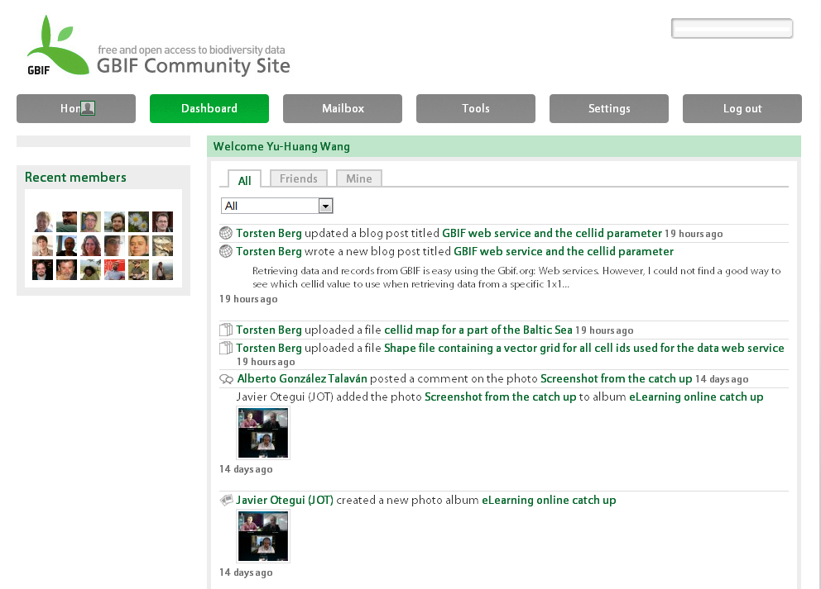
GBIF community site

Slide 6
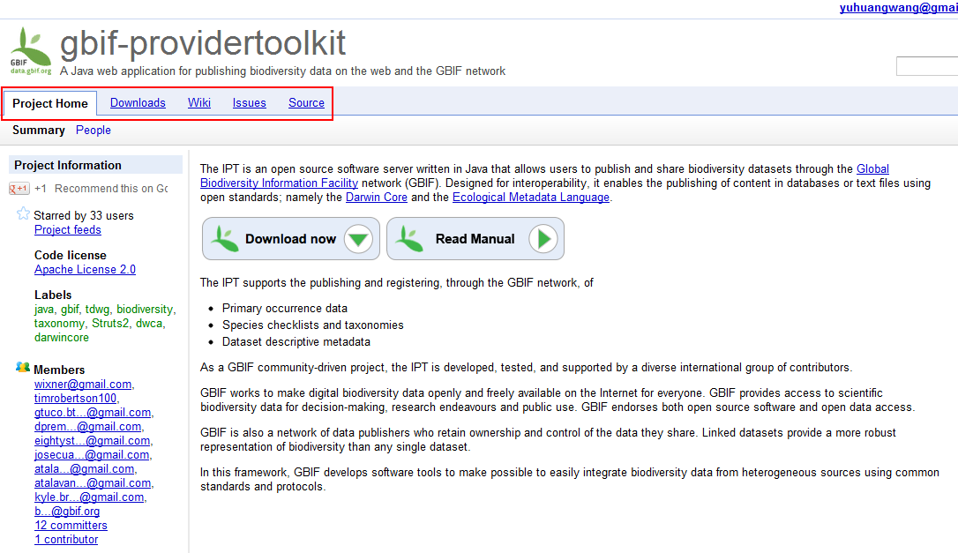
GBIF IPT Google code site
http://code.google.com/p/gbif-providertoolkit/

Slide 7
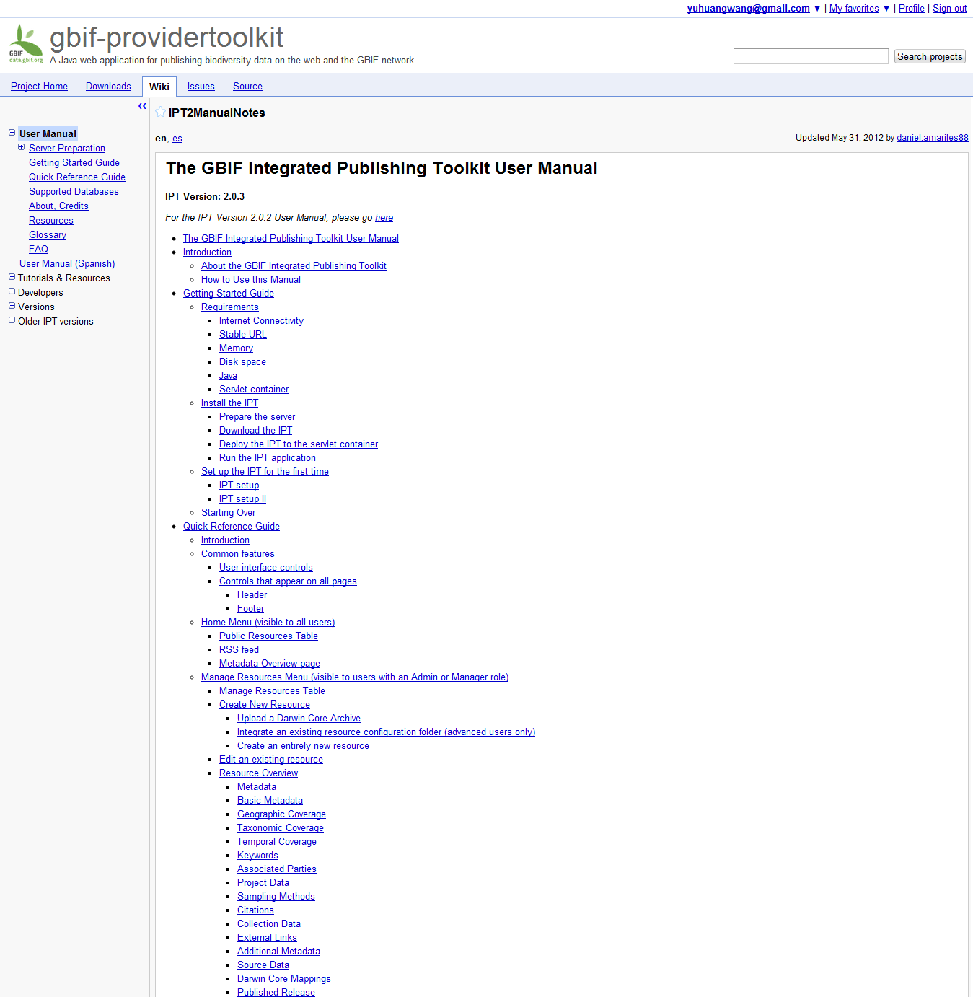
IPT2 online manual
http://code.google.com/p/gbif-providertoolkit/wiki/IPT2ManualNotes?tm=6

Slide 8
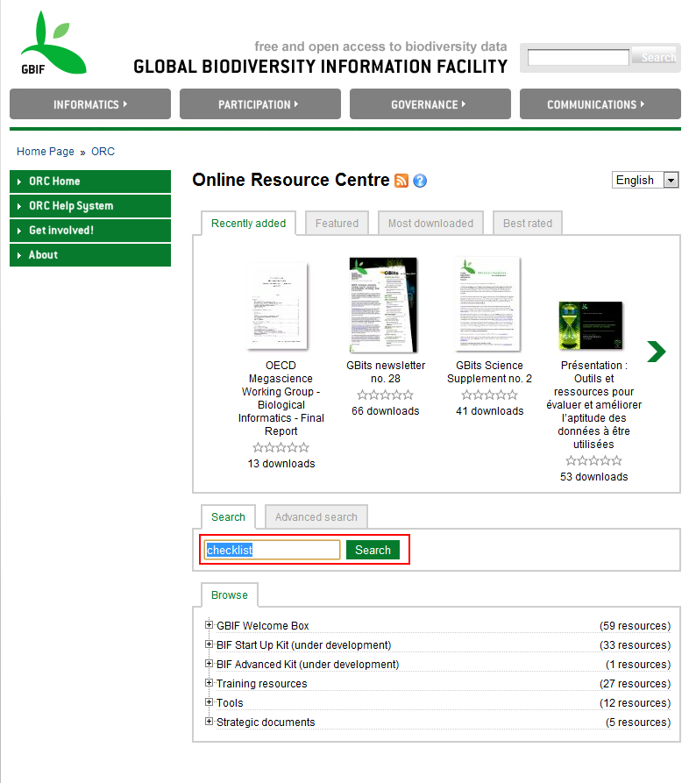
GBIF online resource center
http://www.gbif.org/orc

Slide 9
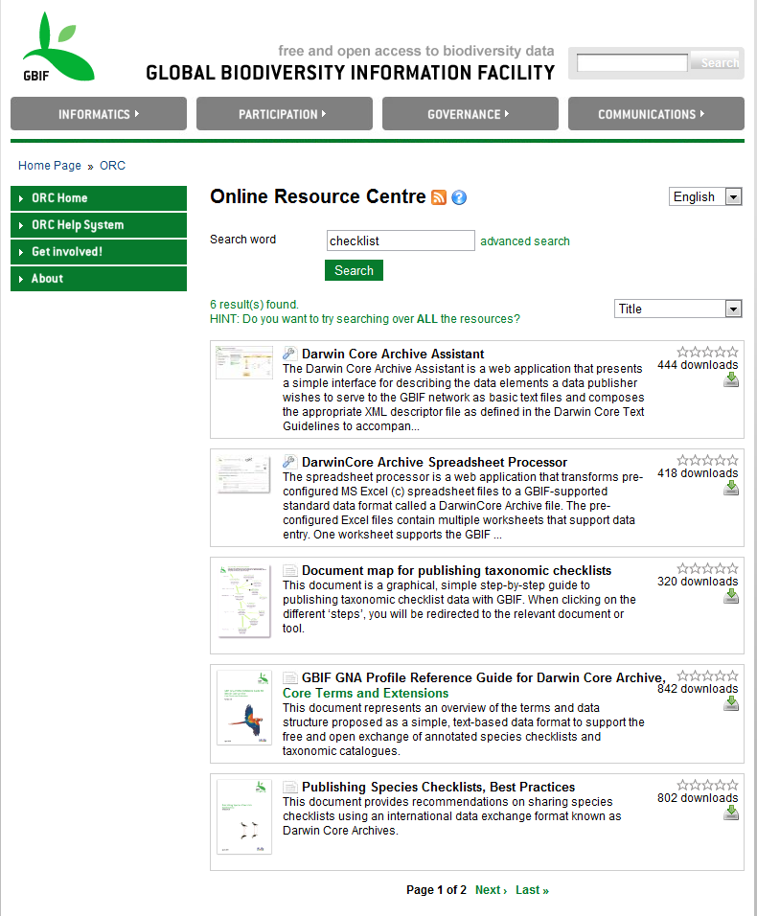
GBIF online resource center

Slide 10
Thank You!
http://taibif.tw

